Slide 1
Lesson 3: Operational Amplifier Circuits in Analog Control
ET 438a
Automatic Control Systems Technology

Slide 2
Learning Objectives
After this presentation you will be able to:
List the characteristics of an ideal Operational Amplifier (OP AMP) circuit.
Identify and utilize fundamental OP AMP circuits to amplify and signals.
Use OP AMP circuits to reduce inter-stage loading effects in sensor circuits.
Average sensor signals using OP AMP circuits.

Slide 3
Ideal OP AMP Characteristics
Z_{out} =0
Zero output resistance
No offset voltage, V_{o}=0 with V_{d}=0
Infinite Z_{in}
I_{in}
Infinite voltage gain, A_{v}
Bandwidth Infinite Gain constant for all f
  I_{in}=0 due to infinite Z_{in}
  Instant recovery from saturation

Slide 4
Non-Ideal OP AMPs
OP AMPs are voltage amplifiers designed originally for use in analog computers
OP AMPs are direct coupled (dc) amplifiers that amplify both ac and dc signals simultaneously. Requires bipolar supplies.
+V
+V_{in}
V₁
-
-V₀
V₁>0, V_{o}<0
V_{o}
+V_{in}
V₂
+
+V₀
V₂>0, V_{o}>0
-V
Schematic symbol for non-ideal OP AMP
Two inputs: V₁ = inverting input
V₂ = non inverting input

Slide 5
Fundamental OP AMP Circuits
Inverting Voltage Amplifier
Non-Inverting Voltage Amplifier
V_{o} Limited by saturation
Large A_{v} causes V_{o} = ±V
R_{in} = R_{in} of OP AMP
A_{v} has minimum value of 1

Slide 6
Voltage Follower Circuit
Voltage follower (Impedance buffer) circuit used to reduce circuit loading. (Has a high Z_{in} and low Z_{out})
+V
Circuit causes minimum loading on previous stage
Z_{o}
Z_{in}
-V
Characteristics
Practical Circuit (LM741) Ideal
A_{v} = 1 A_{v} = 1
Z_{in} = 1 MΩ Z_{in} = infinite
Z_{o} = 10 Ω Z_{o} = 0

Slide 7
Example 3-1 Buffered Voltage Divider Circuit
Voltage divider formula only valid for infinite load resistance
+12 Vdc
Find V_{o} under load
10k
5k = R_{L}
5k
V_{o}
ANS

Slide 8
Example 3-1 Buffered Voltage Divider Circuit (1)
Add impedance buffer
Find V_{o} with load and OP AMP buffer
Assume LM741 with R_{i}=1 MΩ and
R_{o} =10 Ω A_{V}= 1 so V_{in} = V_{o}
+12 Vdc
R_{o}
10k
5k
5k = R_{L}
V_{o}
R_{in}
ANS

Slide 9
Electronic Addition and Subtraction
Inverting Summing Amplifier
Find total output using superposition
Grounded
Gain v₁
Grounded
Grounded
Gain v₂
Ideal
circuit
Gain v₃
Total output
Output is inverted sum of v₁, v₂, and v₂

Slide 10
Electronic Addition and Subtraction
Improved circuit (non-ideal OP AMP)
Practical OP AMP chips require
bias currents to operate. Unequal R values at each input
cause voltage differences that produce output errors.
Bias compensation R
R_{c} = R₁ || R₂ || R₃ || R_{f}

Slide 11
Electronic Addition and Subtraction
Non-inverting Summing Amp
Assuming R₁ = R₂ = R₃
For any number, n, inputs.
n input average
Assuming R₁=R₂=R₃=...R_{n}

Slide 12
Example 3-2 Non-inverting Averager
For circuit shown n=3 R₁ = R₂ = R₃=56k
R_{f} = 9k R = 1k
V₁ = 0.5 Vdc
V₂ = 0.37 Vdc
V₃ = 0.8 Vdc Find V_{o}
ANS

Slide 13
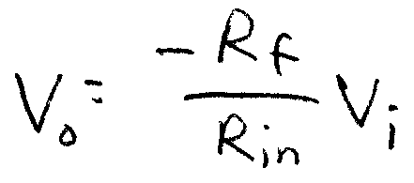
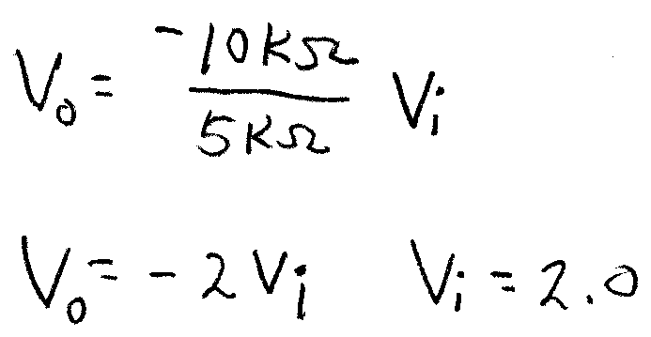
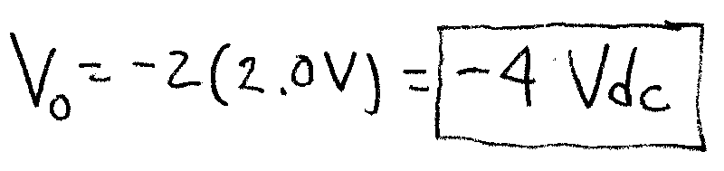
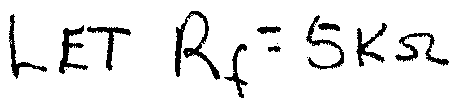
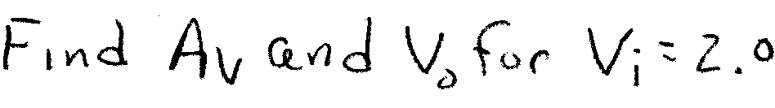
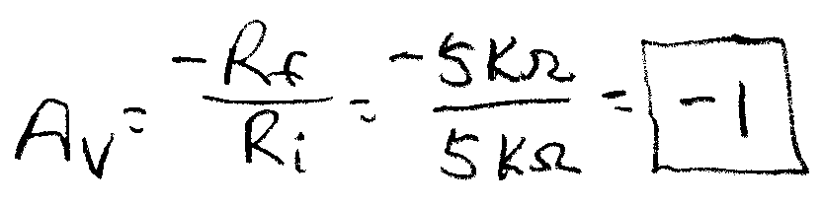
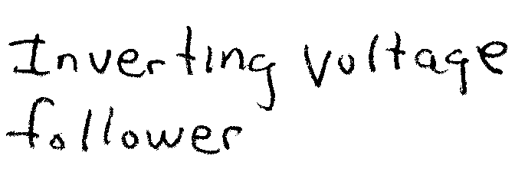
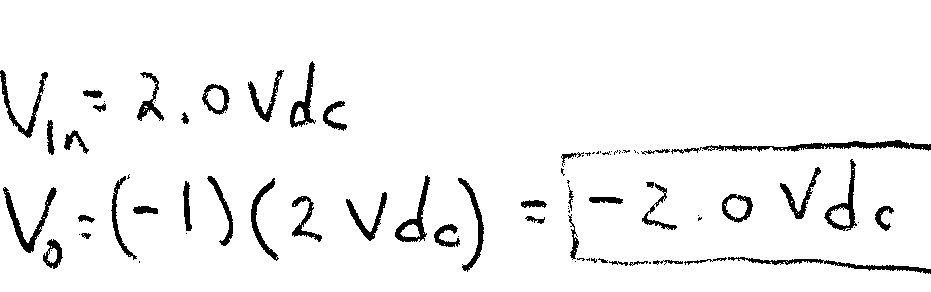
Example 3-3:Inverting Amplifier
For the circuit shown find V_{o} with V_{in} = 2 Vdc
10k
5k

Slide 14
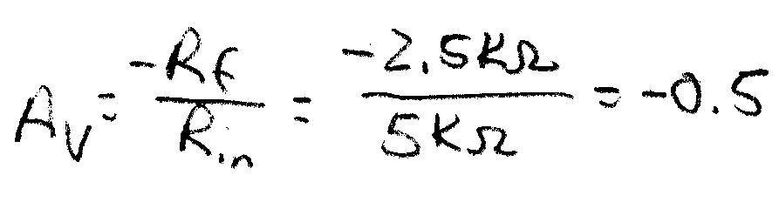
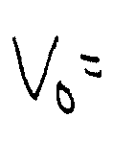
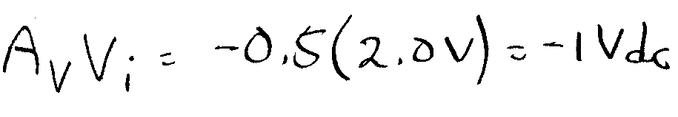
Example 3-3: Solution (2)
2.5k
Let R_{f}= 2.5 kΩ and find
A_{v} and V_{o} for V_{i}= 2.0 Vdc
5k
Reduces input voltage
Output is smaller than input. Circuit divides input by 2
(0.5 = ½)

Slide 15
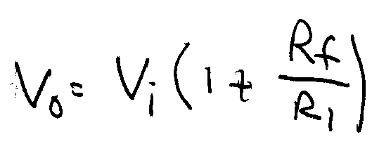
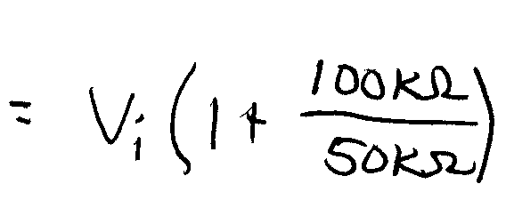
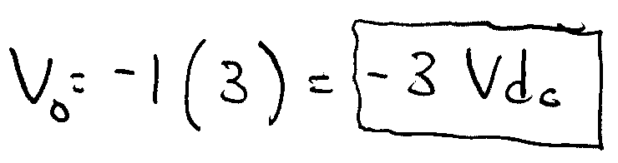
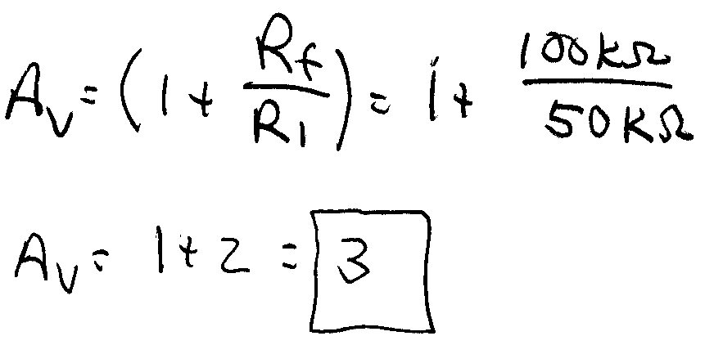
Example 3-4 Non-Inverting Amp (1)
Find V_{o} and A_{v} Given values of R and V_{i} = -1 Vdc. Assume non-ideal OP AMP with power supply values of ±15 Vdc
50k
100k
+15
R_{in}
No sign change
-15
Note: R_{in} of non-inverting OP AMP is infinite (Ideally). Circuit will not load previous stage significantly

Slide 16
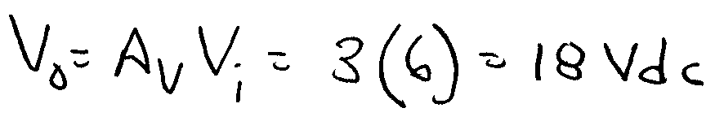
Example 3-4 Solution (2)
50k
100k
V_{in} rises to 6 Vdc. What is V_{o}? Assume a non-ideal OP AMP with given power supply values of ±15 Vdc
+15
-15
This value can’t be achieved since the OP AMP saturates between 13-15 Vdc. Power supplies limit output. Ac signals distorted (clipping)

Slide 17
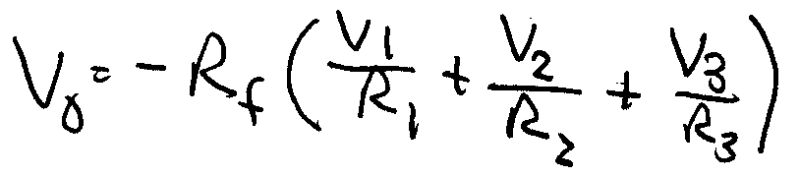
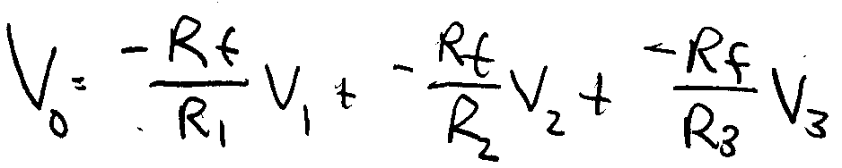
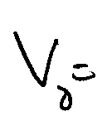
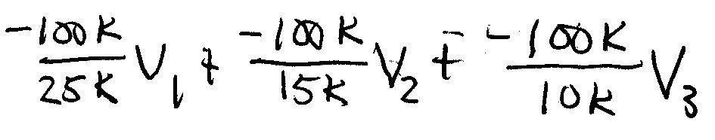
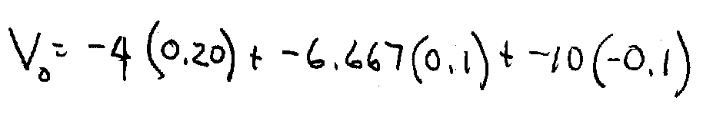
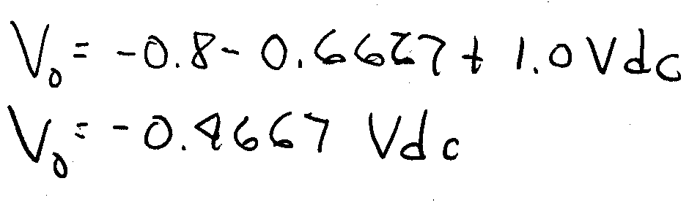
Example 3-5 Inverting Summing Amplifier
Find V_{o} given v₁ = 0.2 Vdcv₂ = 0.1 Vdc
v₃ = -0.1 Vdc
25k
15k
100k
+15
10k
-15
Gains

Slide 18
Summing Amplifier Applications
Letting R₁, R₂ and R₃ be potentiometers produces an audio mixer
When R₁=R₂=R₃
Output voltage is the average of the input values

Slide 19
Example 3-6: Averaging Sensor Signals
50k
50k
50k
LM34 - temperature sensors. Gain = 10 mV/F
T₁ = 50 F T₂ = 45 F T₃= 50 F
Average the temperature using a gain of -1 and -5. Find the
value of R_{f} and V_{o} for each gain value.

Slide 20
Example 3-6 Solution (1)
To average let R₁=R₂=R₃=50 kΩ
Summing equation
Since R₁=R₂=R₃
Find relationship for average with 3 inputs and gain of -1

Slide 21
Example 3-6 Solution (2)
Complete Algebra to
find value of R_{f}
Make equation more general by letting n be the number of inputs
and A_{v} be the desired gain factor.

Slide 22
Example 3-6 Solution (3)
Equate the OP AMP output and the average formula
Use this formula
Find sensor output voltages using temperature and gain value

Slide 23
Example 3-6 Solution (4)
Find R_{f} and V_{o} for a gain of -1 and R₁=50 kΩ, n=3
ANS
ANS
Use average
formula to
check output
Checks

Slide 24
Example 3-6 Solution (5)
Find R_{f} and V_{o} for a gain of -5 and R₁=50 kΩ, n=3
ANS
ANS
Note: both values of R_{f} are not standard values. Use potentiometer
and closest standard value then calibrate circuit to get desired output
Practical R_{f}

Slide 25
Differential Voltage Amplifier
Differential Voltage Amplifier Circuit
Input/output Formula
To simplify let
R1 = R3 R2 = R4
Amplifiers the difference between + - terminals

Slide 26
Differential Amplifier Applications
Can use voltage differential amp to generate an error signal
Measured
value
r
+
e
m
e
-
r
m
error
setpoint
Block diagram
e=r-m

Slide 27
End Lesson 3: Operational Amplifier Circuits in Analog Control
ET 438a
Automatic Control Systems Technology

